Slide 1
Next Generation DNA Synthesis
HTGAA
MIT Molecular Machines (Jacobson) Group - jacobson@media.mit.edu

Slide 2
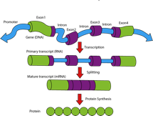
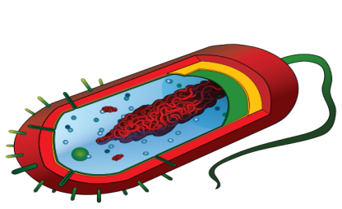
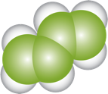
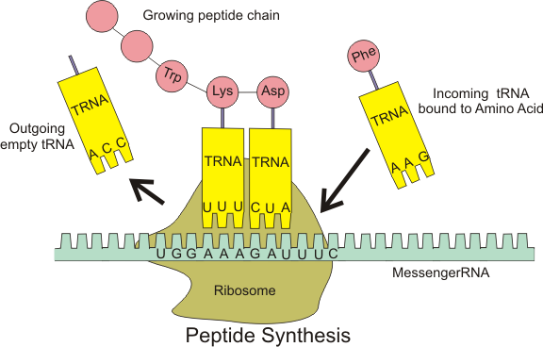
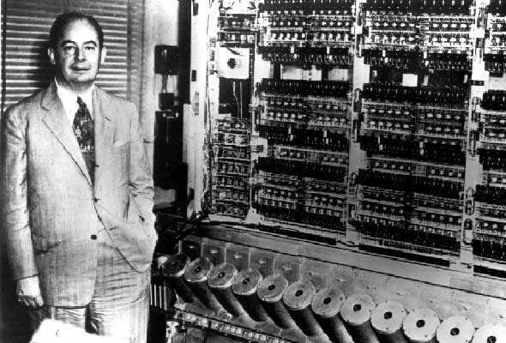
Synthetic Biology
Using Synthetic Genes…
to Program Cells to Become
Factories to Make…
Devices, Sensors, Pharmaceuticals, Renewable Chemicals & Fuels and Food
only 10⁶ times smaller Like this
Ribosome
Tape Programming of the Mark I Computer

Slide 3
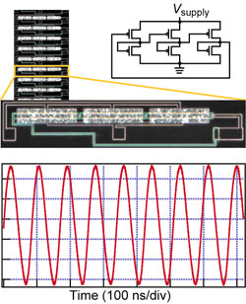
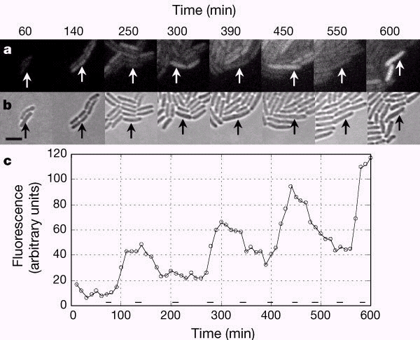
Cells as Computers and Logic
Ring Oscillators from Transcriptional-Translational Logic
http://echinacea.harvard.edu/research/image-gallery/
MB Elowitz MB and S Leibler (2000) A synthetic oscillatory
network of transcriptional regulators.Nature.403 :335 - 338.

Slide 4
Bacterial Ring Oscillators
Jeff Hasty - UCSD
http://elowitz.caltech.edu/
BBa_R0051
BBa_R0040
BBa_R0010
P
RBS
tetR
T
T’
P
RBS
lacI
T
T’
P
RBS
cI
T
T’
BBa_C0040
BBa_C0012
BBa_C0051
BBa_R0063
BBa_R0051
BBa_R0010
P
RBS
luxR
T
T’
P
RBS
luxI
T
T’
P
RBS
aiiA
T
T’
BBa_C0062
BBa_C0061
BBa_C0060
BBa_R0040
P
cfp
ori
res
RBS
BBa_E0022
T
T’
backbone plasmid
BB prefix
BBa_B0001
RBS
BBa_B0030
BB suffix
T
BBa_B0010
T’
BBa_B0012

Slide 5
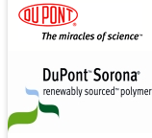
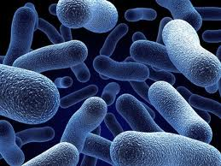
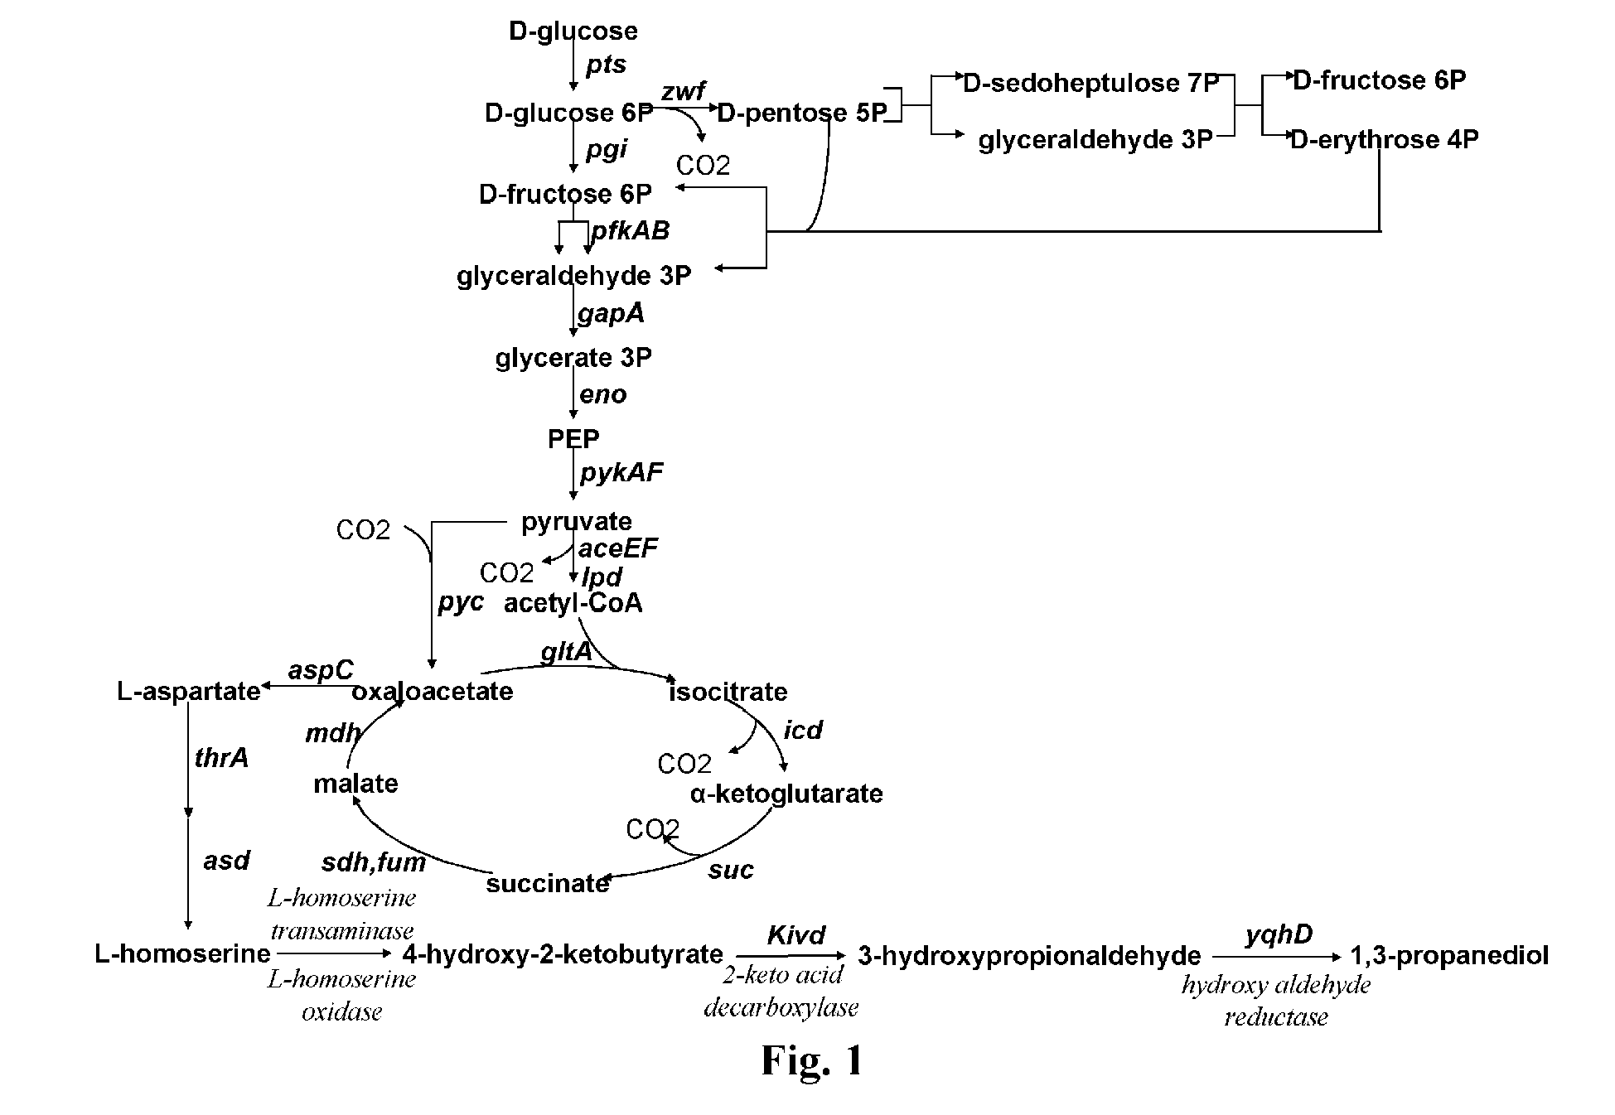
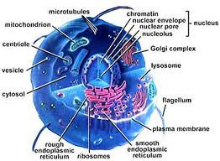
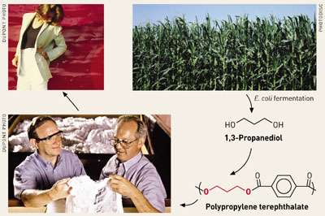
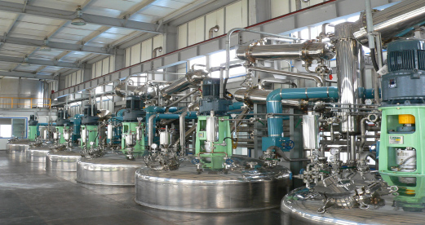
Cells as Chemical Factories
1,3 Propanediol
http://www.latonkorea.com/Plant.html
http://3rdpartylogistics.blogspot.com/2011/10/genetic-bacteria-genetic-modification.html
http://3rdpartylogistics.blogspot.com/2011/10/genetic-bacteria-genetic-modification.html
http://www.latonkorea.com/Plant.html

Slide 6
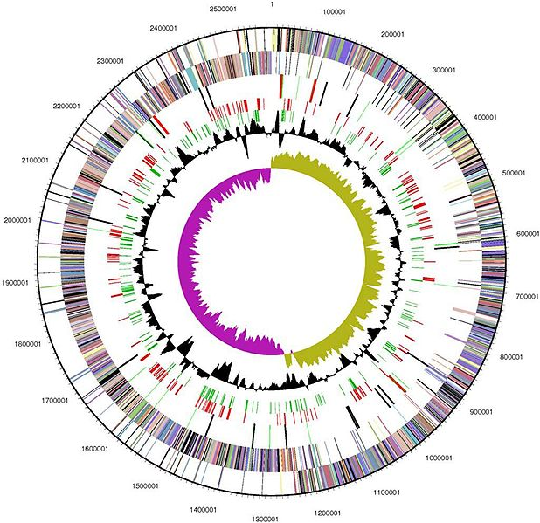
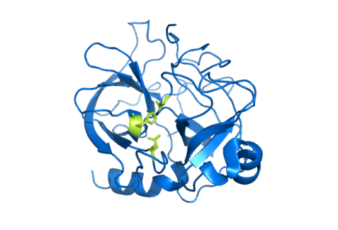
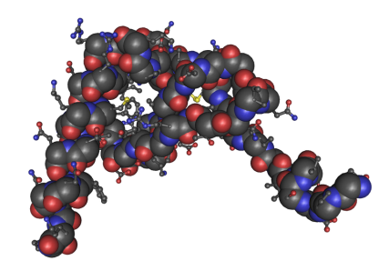
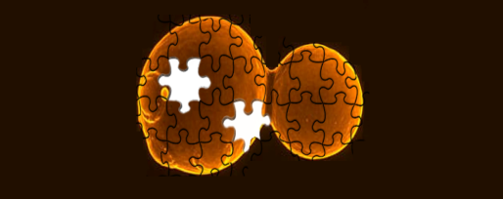
Synthesizing GenBank
GenBank Release 194 : 260,000 Organisms : >150 Billion Bp : > 25 B ESTs : Growing ~60% Per Year (18 Month Doubling)
Enzyme Homologs
Human Drug Targets
(Proteins)
1000 Enzymes * 1000 Homologs
= 1.5 Gb
100,000 Splice Variants *1.5 Kb
= 150 Mb
Synthetic Yeast 2.0 - Building the World's First Synthetic Eukaryotic Genome
Sources:
http://commons.wikimedia.org/wiki/File:CallystatinA-modular.jpg
http://commons.wikimedia.org/wiki/File:1ESR_Human_Monocyte_Chemotactic_Protein-2_01.png
http://commons.wikimedia.org/wiki/File:Chymotrypsin_enzyme.png
http://www.ncbi.nlm.nih.gov/pmc/articles/PMC2238942/
http://commons.wikimedia.org/wiki/File:Halo_genome.jpg

Slide 7
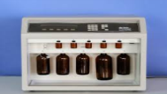
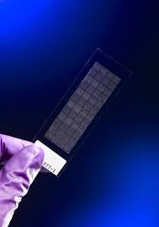
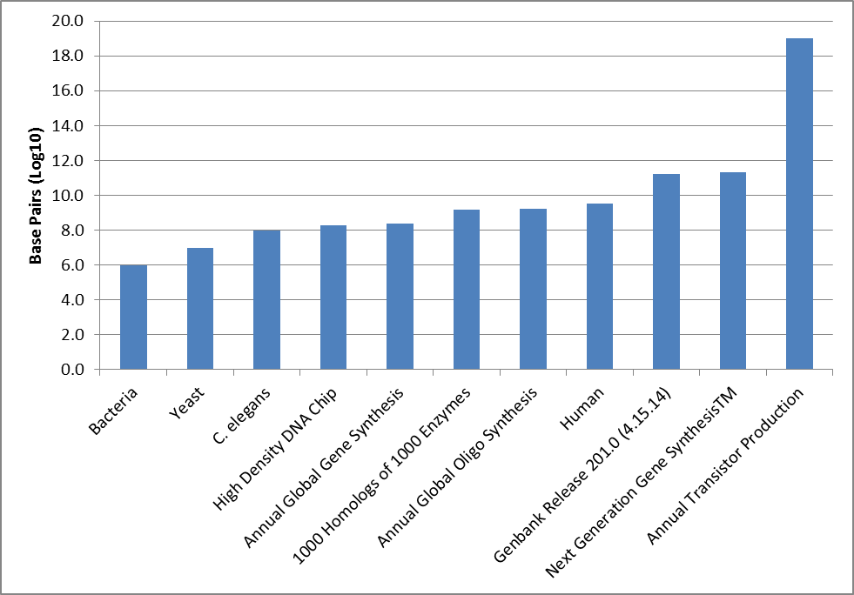
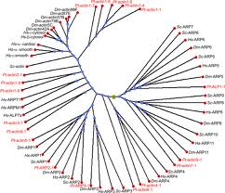
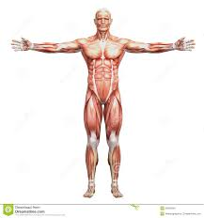
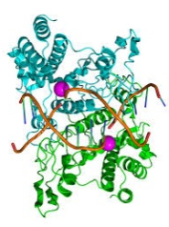
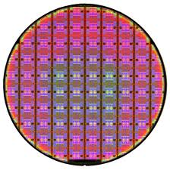
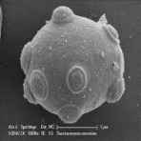
Scale Factors in DNA Synthesis & Applications
Next Generation (Chip Based) DNA Synthesis
100T
1T
Base Pairs
10G
100M
10000000000 G Transistors
1M
97 Mbp
~ 50 Mbp
~ 250 Mbp
~ 1.5 Gbp
~ 1.6 Gbp
~ 3.2 Gbp
159.8 Gbp
~ 200 Gbp
12.2 Mbp
~1-13 Mb
J. Jacobson – MIT CBA – 5.1.14

Slide 8
Next Generation Sequencing
https://raw.githubusercontent.com/lmmx/shots/master/2015/May/Illinois-BioE416-Illumina-polonies.jpg

Slide 9
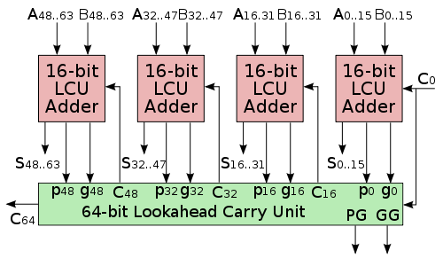
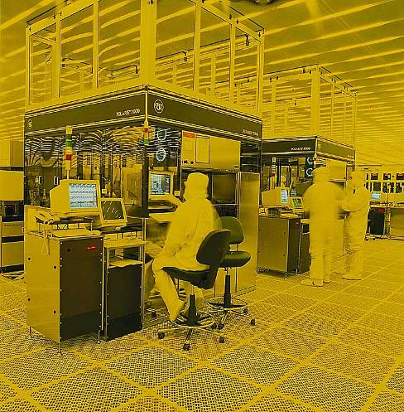
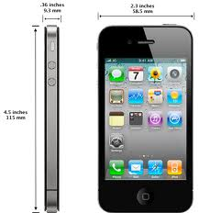
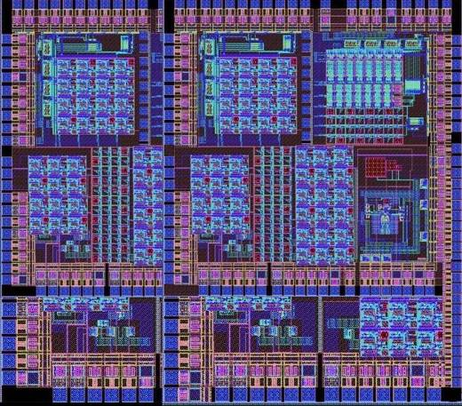
Silicon
1
2
From Schematic Design
To Fab
4
3
To Product
To Working Chip
http://www.national.com/company/pressroom/gallery/graphics/full_sized/06_rgb.jpg http://commons.wikimedia.org/wiki/File:InternalIntegratedCircuit2.JPG http://en.labs.wikimedia.org/wiki/File:64-bit_lookahead_carry_unit.svg
Notes:
9
9

Slide 10
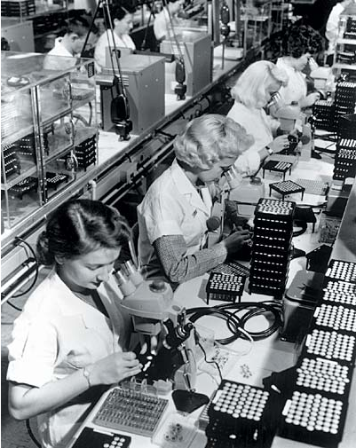
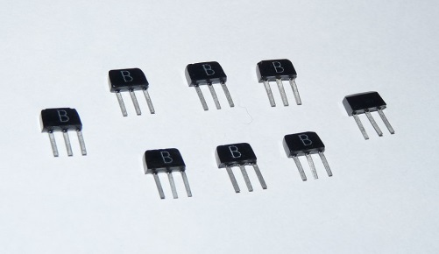
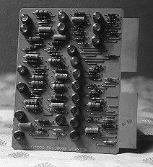
The Tyranny of Numbers
http://www.webenweb.co.uk/museum/comps.htm
http://www.chipsetc.com/the-transistor.html

Slide 11
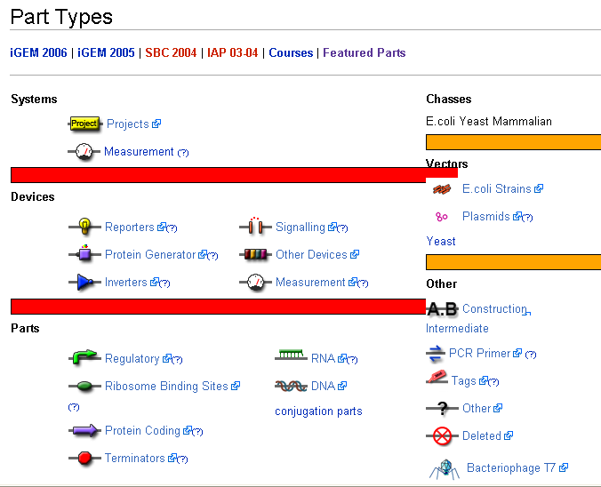
Bio Parts for Synthetic Biology
parts.igem.org

Slide 12
BioFAB - From Bits to Cells
A
B
C
D
A. Gene pathway sequence. B. Corresponding array of overlapping oligonucleotides C. Error correcting assembly in to low error rate pathways. D. Expression in cells

Slide 13
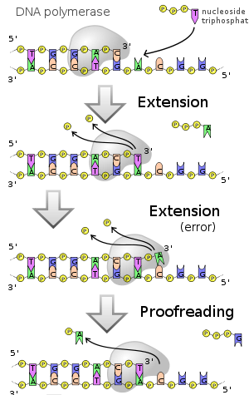
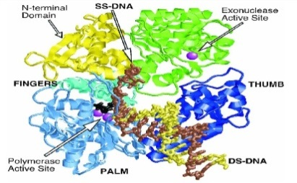
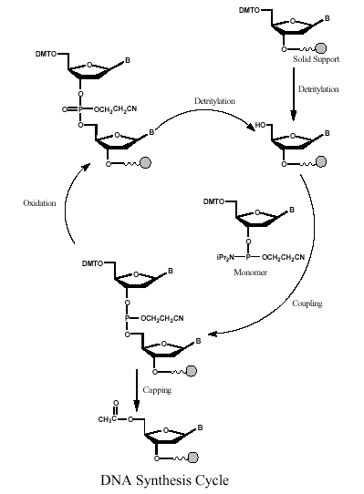
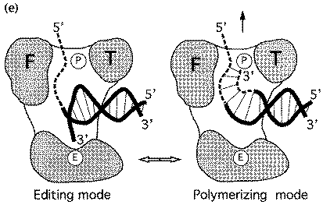
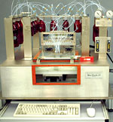
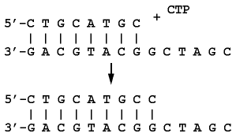
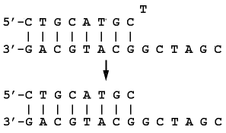
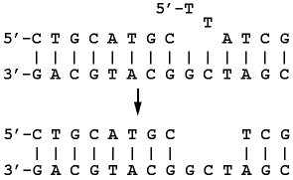
DNA Synthesis
Chemical Synthesis (Open Loop Protection Group) | Biological Synthesis (Error Correcting Polymerase)
Error Rate: 1:10² Throughput: 300 S per Base Addition http://www.med.upenn.edu/naf/services/catalog99.pdf
Throughput Error Rate Product Differential: ~10⁸
Error Rate: 1:10⁶
Throughput: 10 mS per
Base Addition
Beese et al. (1993), Science, 260, 352-355. http://www.biochem.ucl.ac.uk/bsm/xtal/teach/repl/klenow.html
template dependant 5'-3'
primer extension
3'-5' proofreading
exonuclease
5'-3' error-correcting
exonuclease

Slide 14
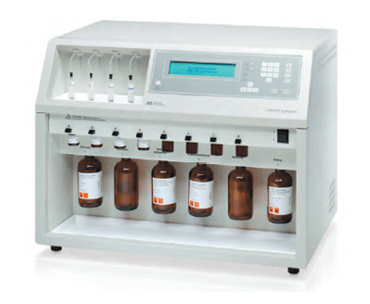
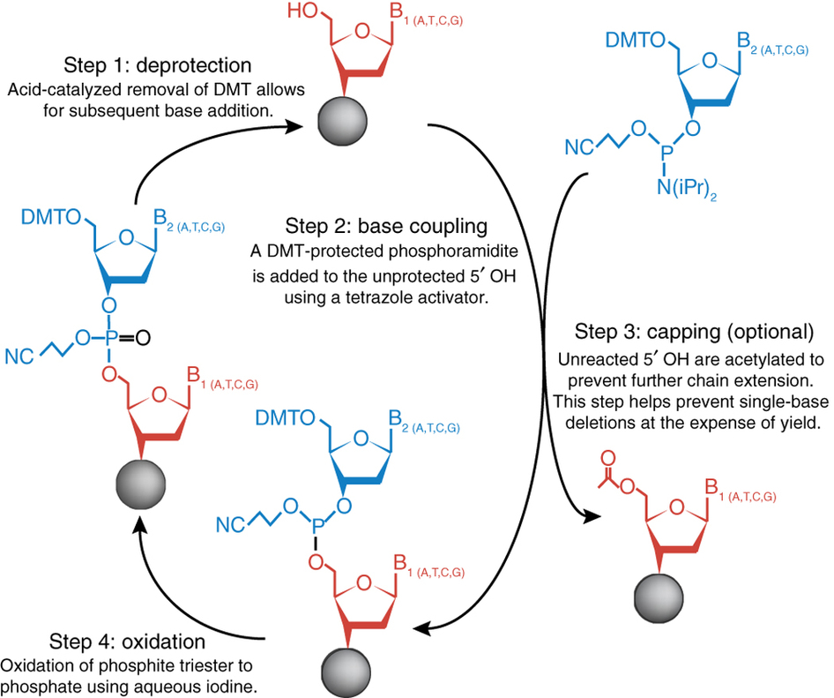
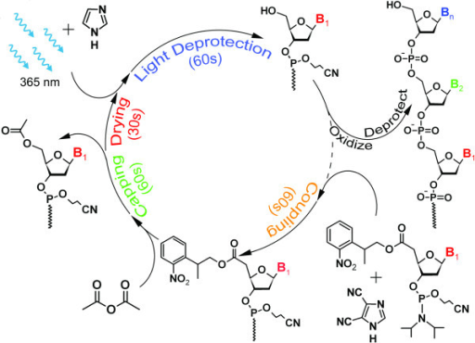
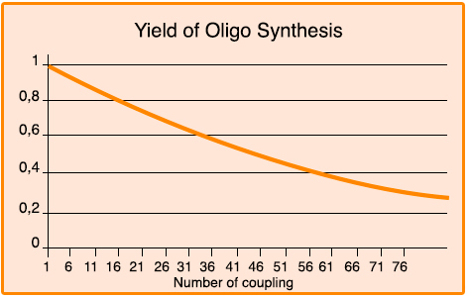
Phosphoramidite DNA Synthesis Cycle
Acid Based Deprotection
Light Based Deprotection
5 Minute Cycles
Machine ~ .5 Mbp / yr
$${(1−\frac{1}{N})}^{N}≈37\%$$
http://www.nature.com/nmeth/journal/v11/n5/images/nmeth.2918-F2.jpg

Slide 15
Up to 1M Oligos/Chip 50 Mbp for ~ $1K (instead of ~$1M)
Inventing a Better Future
Chip Based Oligo Nucleotide Synthesis
~1000x Lower Oligonucleotide Cost
F. Cerrina et. al Nature Biotech 1999 p. 974

Slide 16
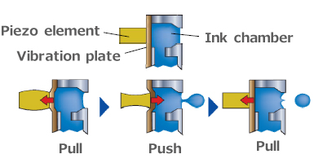
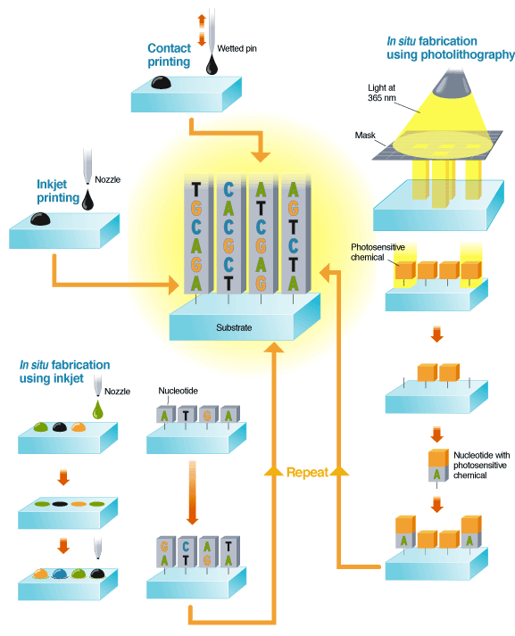
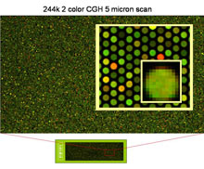
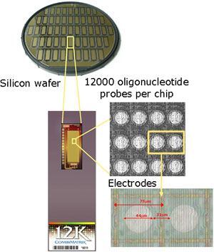
Next Generation (Chip Based) DNA Synthesis
Up to ~ 1M Oligos/Chip

Slide 17
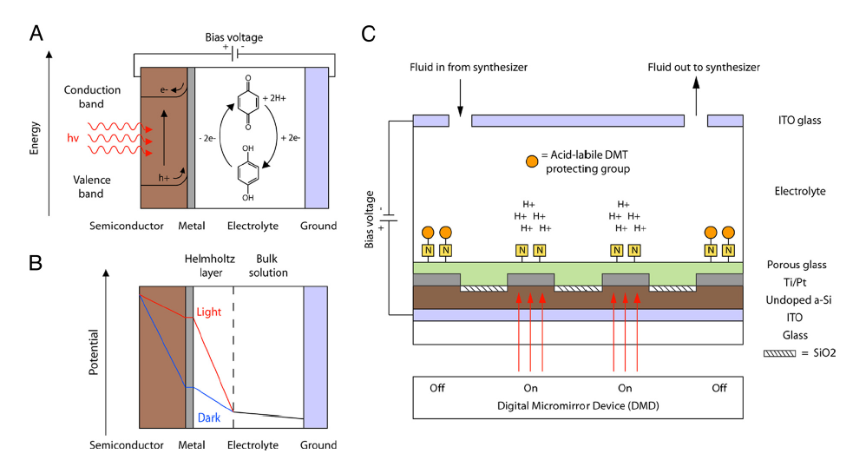
~ 1M Oligos/Chip
Next Generation (Chip Based) DNA Synthesis
~1000x Lower Oligonucleotide Cost
Chow, Brian Y., Christopher J. Emig, and Joseph M. Jacobson. "Photoelectrochemical synthesis of DNA microarrays." Proceedings of the National Academy of Sciences 106.36 (2009): 15219-15224.
http://www.technologyreview.com/biomedicine/20035/
http://learn.genetics.utah.edu/content/labs/microarray/analysis
Accurate multiplex gene synthesis from programmable DNA microchips
Jingdong Tian, Hui Gong, Nijing Sheng, Xiaochuan Zhou, Erdogan Gulari, Xiaolian Gao and George Church
Nature 432, 1050-1054(23 December 2004)
doi:10.1038/nature03151

Slide 18
Error Correction
MutS Repair System
Lamers et al. Nature 407:711 (2000)

Slide 19
Error Correcting Gene Synthesis
Error Rate 1:10⁴
Nucleic Acids Research 2004 32(20):e162

Slide 20
Error Reduction: GFP Gene synthesis

Slide 21
Generating a synthetic genome by whole genome assembly: φX174 bacteriophage from synthetic oligonucleotides
AGCTAGCTAGTTTTTTTTTT
GGGGGGGGGGAAGGCCTTAA
AAAAAAAAAACCCCCCCCCC
http://www.pnas.org/content/100/26/15440/F1.large.jpg

Slide 22
Gibson Assembly
https://www.neb.com/~/media/Catalog/All-Products/0AA961B294E444AFBEDD5C4A904C76E6/Long%20Description/E2611a.jpg

Slide 23
Multiplex Synthesis
Kosuri, Sriram, et al. "Scalable gene synthesis by selective amplification of DNA pools from high-fidelity microchips." Nature biotechnology 28.12 (2010): 1295-1299.

Slide 24
Chip Based Gene Synthesis
1
2
Accurate multiplex gene synthesis from programmable DNA microchips
Jingdong Tian, Hui Gong, Nijing Sheng, Xiaochuan Zhou, Erdogan Gulari, Xiaolian Gao and George Church
Nature 432, 1050-1054(23 December 2004)
doi:10.1038/nature03151
Parallel gene synthesis in a microfluidic device
D.S. Kong, P.A. Carr, L. Chen, S. Zhang, J.M. Jacobson Nucleic Acid Research , 2007, Vol. 35, No. 8 e61

Slide 25
http://www.synthesis.cc/assets_c/2014/02/Carlson_Price_Seq_Synth_Feb2014.html

Slide 26
GC = 10%
Minimum Free Energy Secondary Structures : 25⁰ C
TCACAAATTAATTTTAATTCCTATT
TATATAAAGACTAATTTATAAGATT
ATCTAATATCTTAGTGATAAAATTT
A/T ~ -1.2kcal/mol
G/C ~ -2.0 kcal/mol

Slide 27
Base Pairing Energies
CCCCCCCCCCCCCCCCCCCCCCCCGGGGGGGGGGGGGGGGGGGGGGGG
G/C ~ -2.0 kcal/mol
CCCCCCCCCCCCCCCCCCCCCCCC
GGGGGGGGGGGGGGGGGGGGGGGG

Slide 28
GC = 50%
Minimum Free Energy Secondary Structures : 25⁰ C
AGATATACTCGGTATACGAGTCCCG
GGAGGTTAATCCACCATGTCTCCGT
TAACCCTCCGATCACTATTTGAATT

Slide 29
GC = 50%
Minimum Free Energy Secondary Structures : 25⁰ C
TCTAAGGGAATTCAGAGAACACTAG

Slide 30
GC = 90%
Minimum Free Energy Secondary Structures : 25⁰ C
CCCGCACGCGCGCCCGCCCCCCGGC
CCCGGCCCCGTAGCGCACCCGCCGG
CGGGGGCGGCGAACGGGACGCCGGC

Slide 31
Putting The Pieces Together
Minimum Free Energy Secondary Structures : 25⁰ C
1
2
AGCTAGCTAGTTTTTTTTTT
GGGGGGGGGGAAGGCCTTAA
strand 1- strand2 – strand 3
AAAAAAAAAACCCCCCCCCC
3
strand 1- strand1

Slide 32
Recoding
The Genetic Code
Life’s Operating System

